Slide 1
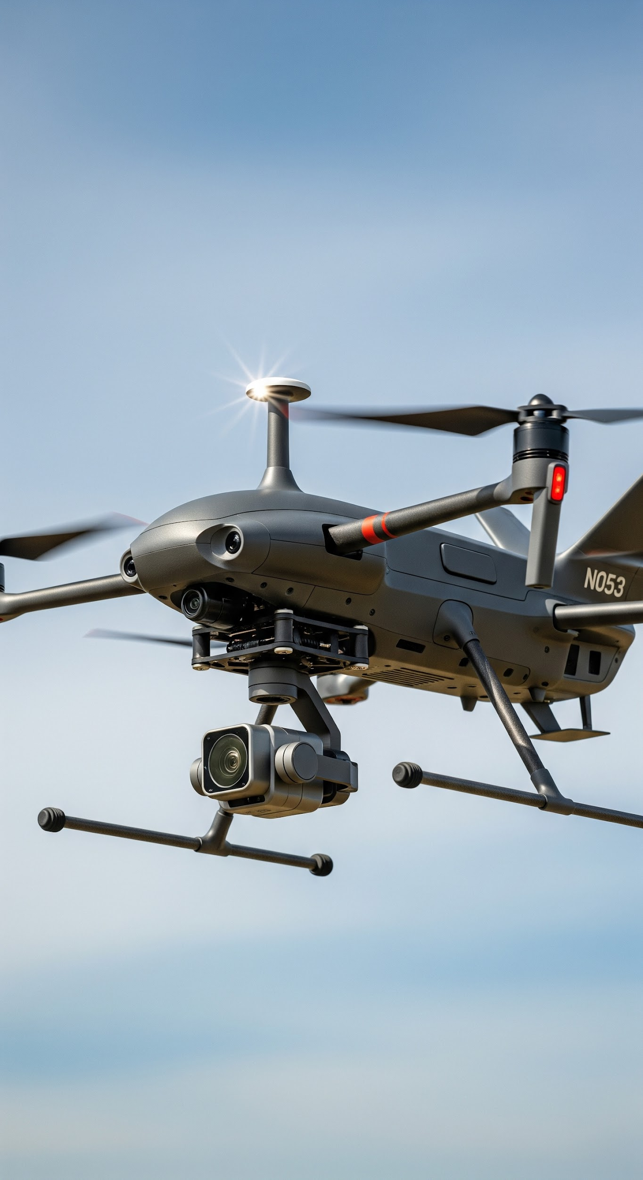
High Altitude Long Endurance (HALE) UAV Sustained Flight through Renewable Energy
Parth Patil 22BTRAS031
Guide: Dr. Amalesh Barai
Department of Aerospace Engineering

Slide 2
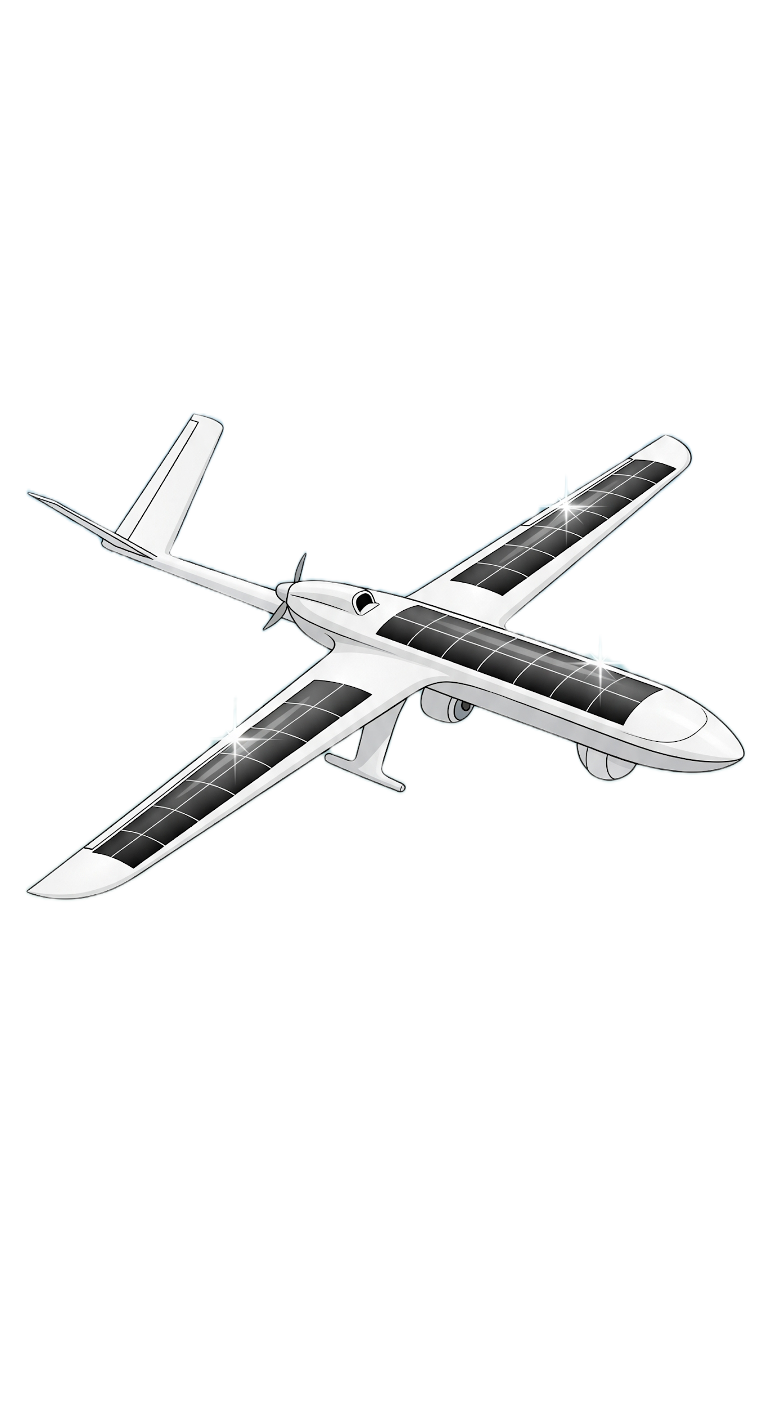
Project Overview
Objective: Theoretical design and feasibility evaluation of a solar-powered HALE UAV.
Focus Areas: Aerodynamics, structure, energy systems, and mission performance.
Motivation: Need for long-endurance, high-altitude platforms for surveillance, communication, and atmospheric monitoring.
Approach: Literature-backed modelling and system-level design specification.

Slide 3
Market Survey
Applications:
Persistent ISR, border surveillance
Climate and atmospheric monitoring
Communication relays (HAPS)
Disaster observation
Observations:
Global push toward satellite alternatives
Growing interest in solar/electric HALE platforms
Demand for multi-day endurance with minimum operational cost
Leading programs: Zephyr, Global Hawk, Helios
Relevance of Research in Current Markets

Slide 4
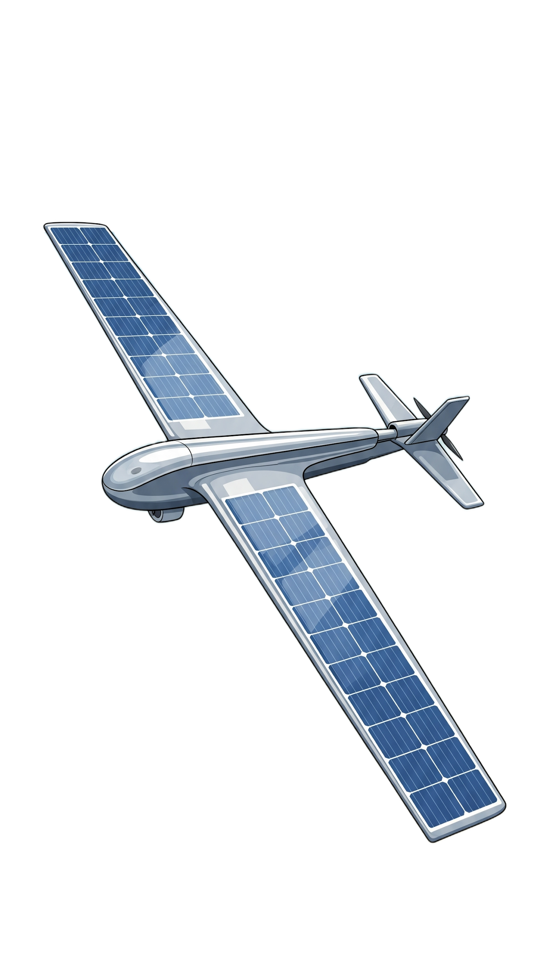
Literature Review
Aerodynamic challenges at low Reynolds numbers
High-aspect ratio wings essential for efficiency
Structural reliance on CFRP composites for stiffness & low weight
Solar cells: triple-junction (25–30% efficiency)
Energy storage bottleneck: night-time endurance
Fuel cells superior to batteries when energy demand >2.8 kWh
Joined-wing configuration highly efficient (span efficiency 1.4–1.5)

Slide 5
Problem Definition
Current HALE systems face:
Insufficient night-time power storage
Aerodynamic penalties at low Re regimes
Flutter and structural deformation in ultra-light wings
Limited hybrid solar–battery–fuel cell integration
Environmental sensitivity (temperature, irradiance, density)
Design and theoretically validate a solar-powered HALE UAV capable of sustained high-altitude flight by optimizing aerodynamic configuration, structural layout, and renewable energy integration.

Slide 6
The theoretical model
Conceptual HALE UAV design is feasible in terms of aerodynamics, solar power generation, and night-time energy storage.
Primary Outputs:
Wing area: 32.0 m²; solar-covered area (95%): 30.4 m².
Aircraft operational mass excluding energy storage: 114.4 kg (weight = 1,121.9 N).
Cruise propulsive power required: 1,346 W.
Electrical power required at system level (including propulsive and electronics losses): 1,994 W.
Incident irradiance at 18–20 km (assumed transmittance 0.90): 1,224.9 W/m².
Solar electrical generation (28% cell eff., after electronics): ≈ 9,384 W.
Night energy required for 12 hours: ≈ 23,933 Wh (23.93 kWh).
Required Li-ion battery mass (250 Wh/kg): ≈ 95.7 kg.
Required hydrogen (LHV 33.3 kWh/kg, fuel cell system eff 50%): ≈ 1.44 kg H₂. With a conservative hydrogen system mass multiplier (×3 to account for tanks and BOP), hydrogen system total mass ≈ 4.31 kg.
Sensitivity:
Solar generation scales with wing area and solar cell efficiency; even at 20% cell efficiency the daytime solar power greatly exceeds cruise power.
Battery mass required for 12-hour night remains large (~96 kg) under the current assumptions and would be impractical as a primary stored-energy solution for a 114 kg airframe.
Using hydrogen fuel cells reduces stored-energy mass dramatically: ~1.4 kg H₂ required for 23.9 kWh (≈1.44 kg H₂), and with system mass multiplier ≈4.3 kg total—far lighter than batteries.

Slide 7
Design Specifications
Mission Requirements:
Altitude: ≥ 18–20 km
Endurance: ≥ 24 hours (target multi-day)
Cruise at low speed for max L/D
Lightweight scientific/communication payload
System Requirements:
High-aspect ratio wing (biplane / BWB / joined-wing)
CFRP composite structure
Triple-junction solar array + Li-ion or fuel cell storage
Stable longitudinal & directional control at low air density

Slide 8
Energy System & Performance Modelling
Solar Modelling:
Energy Storage:
Performance:
Triple-junction cells (25–30% efficiency)
Solar irradiance estimation at 18–20 km
Wing-area-to-power ratio studies
Battery discharge modelling
Fuel cell feasibility (superior for >2.8 kWh)
Day–night energy balance via MATLAB/Simulink
Power requirement increases by 3.5% per km altitude
Energy sustainability validated through theoretical cycle simulation

Slide 9
Key Findings
Hybrid solar and battery/fuel cell system theoretically supports continuous operation
Joined-wing configuration offers best aerodynamic–structural trade-off
Structural analysis supports CFRP-based ultra-light design
Theoretical modelling indicates feasible daytime power surplus and manageable night-time deficit with optimized storage
Performance trends align strongly with validated HALE platforms in literature

Slide 10
Conclusion
Future Work
The project establishes the feasibility of a solar-powered HALE UAV concept by integrating aerodynamic, structural, and energy-system insights. Theoretical evaluation supports long-endurance capability using optimized wing geometry and hybrid energy systems.
High-fidelity CFD and FEM simulations
Scaled prototype fabrication
Real-time atmospheric modelling
Experimental testing of wing sections & hybrid energy systems
Development of onboard energy management algorithms

